Slide 1

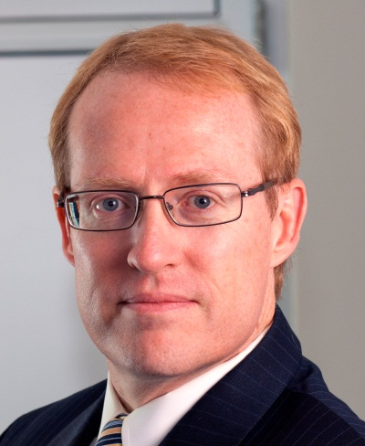

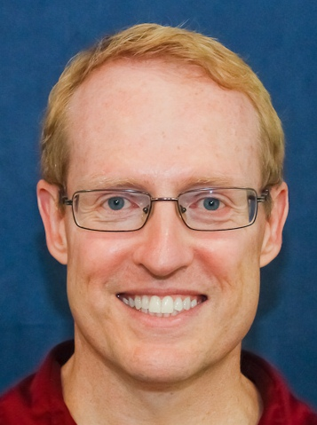

Overview of Frameworks: Part 1
Douglas C. Schmidt
d.schmidt@vanderbilt.edu
www.dre.vanderbilt.edu/~schmidt
Professor of Computer Science
Institute for Software Integrated Systems Vanderbilt University Nashville, Tennessee, USA

Slide 2
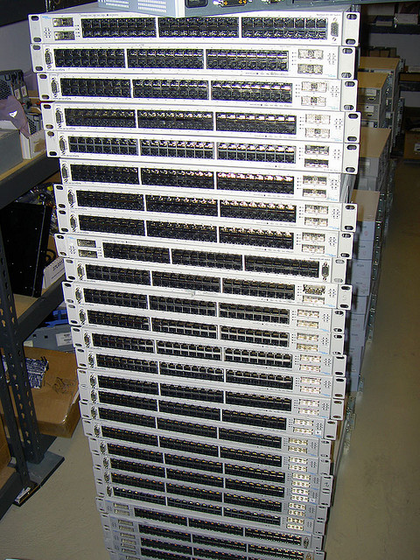
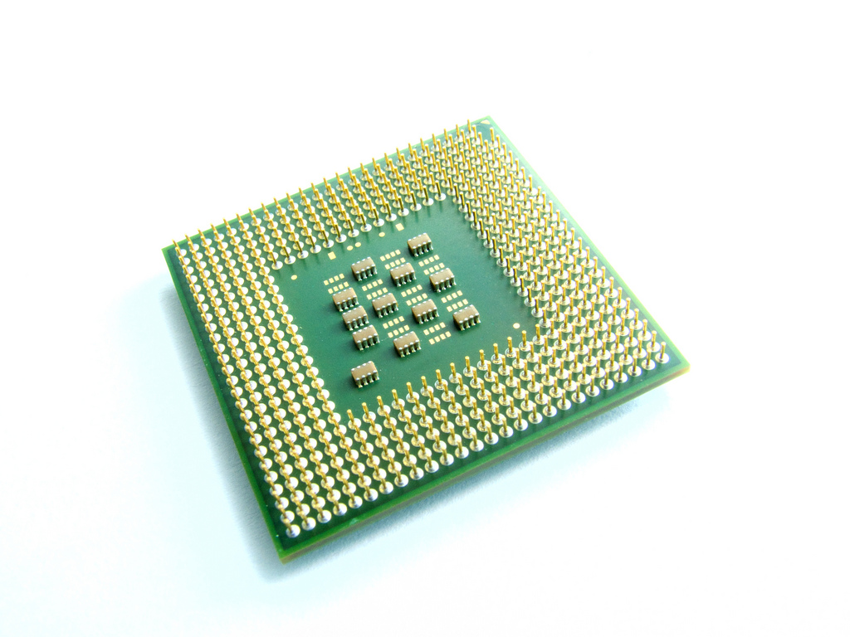
Topics Covered in this Part of the Module
Analyze why hardware has historically improved more consistently than software

Slide 3

Topics Covered in this Part of the Module
Analyze why hardware has historically improved more consistently than software
Describe key characteristics of frameworks that help improve software productivity & quality
Application-specific functionality
Electronic Trading
Mobile
Apps
Social Media
Networking
GUI
Database

Slide 4
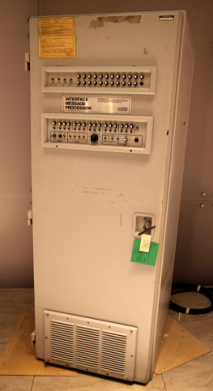
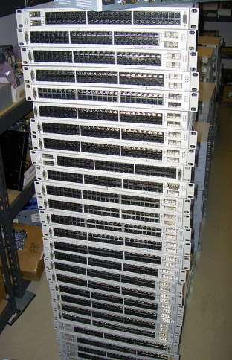
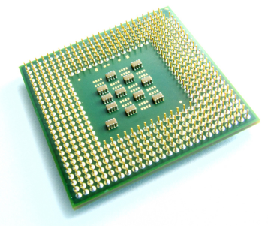
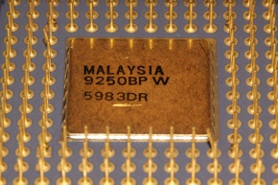
Hardware == Better, Faster, Cheaper
Processor & network performance has increased by many orders of magnitude in past decades
Single-core 10 Megahertz to 3+ Gigahertz multi-cores
1,200 bits/sec to 10+ Gigabits/sec
Notes:
http://www.flickr.com/photos/38451115@N04/3607930297/, X86 chip, http://www.flickr.com/photos/andresrueda/3274875773/sizes/l/, IMP, http://www.flickr.com/photos/44124348109@N01/5114191251/, http://www.flickr.com/photos/10581663@N08/3136861346/

Slide 5
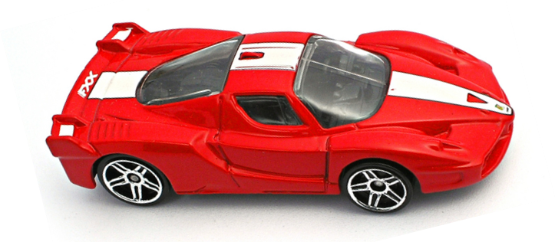
Hardware == Better, Faster, Cheaper
Processor & network performance has increased by many orders of magnitude in past decades
Single-core 10 Megahertz to 3+ Gigahertz multi-cores
1,200 bits/sec to 10+ Gigabits/sec
Extrapolating these trends another decade or so yields high-performance commoditized hardware infrastructure
Processors with 100’s1000’s of cores
~100 Gigabits/sec LANs
~100 Megabits/sec wireless
~10 Terabits/sec Internet backbone
www.dre.vanderbilt.edu/~schmidt/dedicate.html has more on commoditization
Notes:
http://www.flickr.com/photos/38451115@N04/3607930297/, X86 chip, http://www.flickr.com/photos/andresrueda/3274875773/sizes/l/, IMP, http://www.flickr.com/photos/44124348109@N01/5114191251/, http://www.flickr.com/photos/10581663@N08/3136861346/

Slide 6
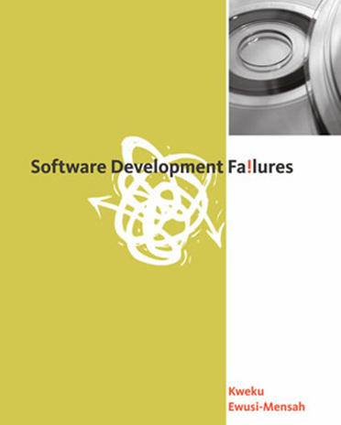


Software == Buggier, Slower, & More Expensive?
Unfortunately, software quality & productivity hasn’t improved as rapidly or predictably as hardware
Notes:
X86 chip, http://www.flickr.com/photos/andresrueda/3274875773/sizes/l/, IMP, http://www.flickr.com/photos/44124348109@N01/5114191251/

Slide 7
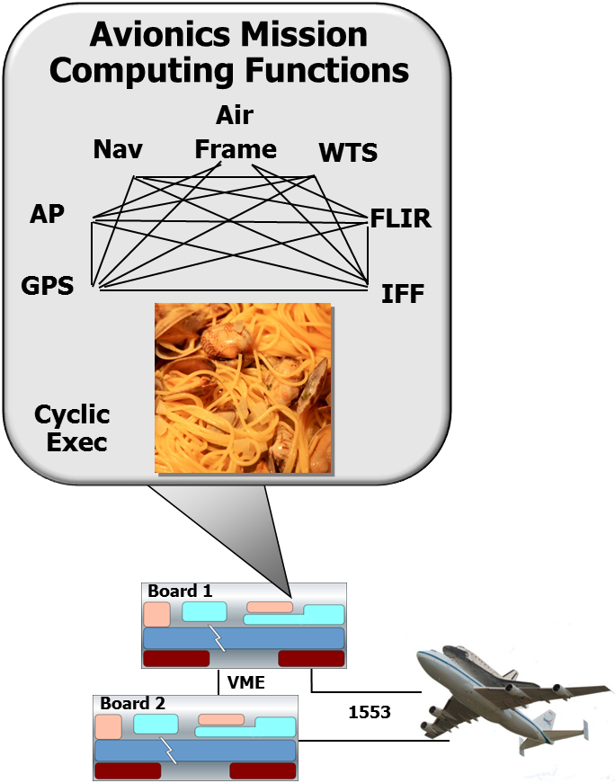
Software == Buggier, Slower, & More Expensive?
Unfortunately, software quality & productivity hasn’t improved as rapidly or predictably as hardware
This is particularly problematic for mission-critical concurrent & networked software-reliant systems
See www.dre.vanderbilt.edu/~schmidt/comm-lessons.html for more info

Slide 8
Why Hardware Improves Consistently
Advances in hardware & networks stem largely from maturation of standardized & reusable interfaces, protocols, & modeling tools
x86 chipsets
TCP/IP switches
Notes:
X86 chip, http://www.flickr.com/photos/andresrueda/3274875773/sizes/l/, Switches, http://www.flickr.com/photos/command-tab/251016235/sizes/z/

Slide 9




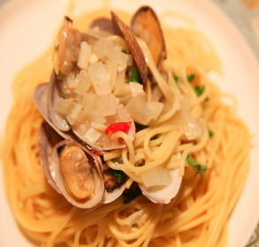
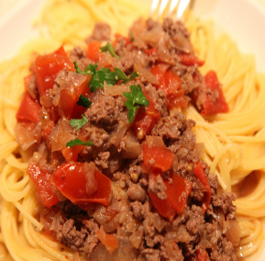
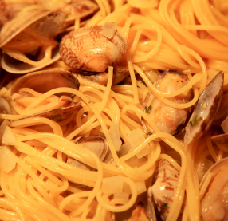
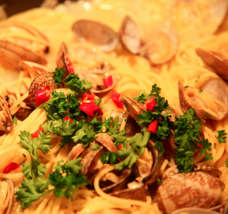
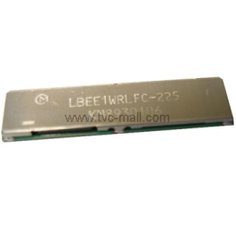
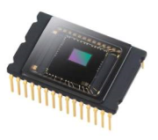
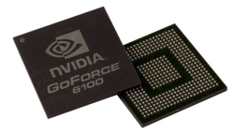
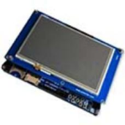
Why Software Fails to Improve as Consistently
In general, software has not been as standardized or reusable as hardware
Customized Form Factors
Proprietary & Stovepiped Application & Infrastructure Software
Standard/COTS Hardware & Networks
Historically software developers have manually rediscovered & reinvented “point solutions” that are expensive to develop, integrate, validate, & sustain
Notes:
http://www.flickr.com/photos/hsuyo/4257133747/sizes/l/, http://www.flickr.com/photos/44613915@N00/4155656358/, http://www.flickr.com/photos/44613915@N00/4257134221/, http://www.flickr.com/photos/44613915@N00/4257134025, http://www.flickr.com/photos/32496077@N03/6988551091/

Slide 10
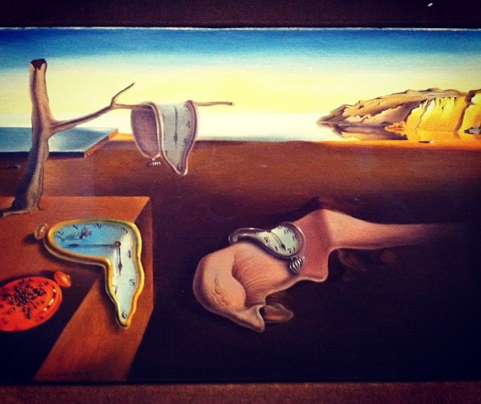
Why Software Fails to Improve as Consistently
In general, software has not been as standardized or reusable as hardware
Customized Form Factors
Proprietary & Stovepiped Application & Infrastructure Software
Standard/COTS Hardware & Networks
Consequence: Small changes in software/hardware have a big (negative) impact on system quality & sustainability
Notes:
http://www.flickr.com/photos/hsuyo/4257133747/sizes/l/, http://www.flickr.com/photos/44613915@N00/4155656358/, http://www.flickr.com/photos/44613915@N00/4257134221/, http://www.flickr.com/photos/44613915@N00/4257134025, http://www.flickr.com/photos/32496077@N03/6988551091/

Slide 11
A Solution: Software Frameworks
A framework is an integrated set of software components that collaborate to provide a reusable architecture for a family of related applications
Product
Variant 2
Product
Variant 3
Product
Variant 4
Customized Form Factors
Product
Variant 1
Bundled & Third-Party Apps
Framework- based App & Infrastructure Software
Application Frameworks
System Libraries
Virtual Machine Runtime
Operating System Kernel
Standard/COTS Hardware & Networks
Frameworks promote “systematic reuse” by factoring out many general- purpose & domain-specific services from traditional application responsibility
www.dre.vanderbilt.edu/~schmidt/reuse-lessons.html has info on systematic reuse
Notes:
http://www.flickr.com/photos/hsuyo/4257133747/sizes/l/, http://www.flickr.com/photos/44613915@N00/4155656358/, http://www.flickr.com/photos/44613915@N00/4257134221/, http://www.flickr.com/photos/44613915@N00/4257134025, http://www.flickr.com/photos/32496077@N03/6988551091/

Slide 12
Key Characteristics of Frameworks
Software frameworks exhibit several key characteristics that differentiate them from other forms of systematic reuse
www.dre.vanderbilt.edu/~schmidt/CACM-frameworks.html has more info

Slide 13
Key Characteristics of Frameworks
They exhibit “inversion of control” via callbacks
AKA, “Hollywood Principle”
Application-specific functionality
See www.dre.vanderbilt.edu/~schmidt/Coursera/articles/hollywood-principle.txt

Slide 14
Key Characteristics of Frameworks
They exhibit “inversion of control” via callbacks
AKA, “Hollywood Principle”
Callbacks on “hook methods”
ACE Acceptor-Connector & Reactor frameworks
Reactor
*
Event Handler
handle_events()
register_handler()
remove_handler()
dispatches
handle_event ()
get_handle()
*
owns
Handle
*
notifies
Runs event loop
handle set
<<uses>>
HTTP
Connector
HTTP
Acceptor
Synchronous
Event Demuxer
select ()
Waits for events to occur
HTTP
Handler
www.dre.vanderbilt.edu/~schmidt/PDF/Reactor1-93.pdf has more on Reactor

Slide 15
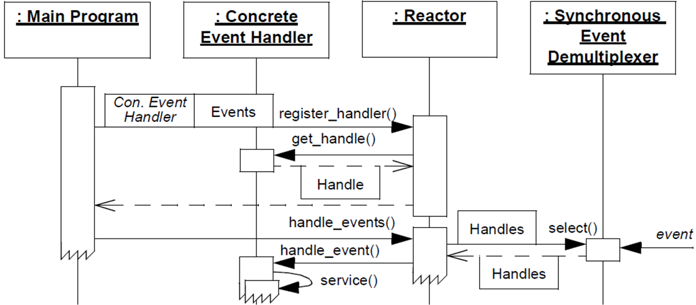
Key Characteristics of Frameworks
They exhibit “inversion of control” via callbacks
AKA, “Hollywood Principle”
ACE Acceptor-Connector & Reactor frameworks
: Main Program
: Concrete Event Handler
: Reactor
: Synchronous Event Demultiplexer
Initialization phase
Start of event handling phase
Store event handlers & handles
Callbacks on hook methods
www.dre.vanderbilt.edu/~schmidt/PDF/Reactor2-93.pdf has more on Reactor

Slide 16
Key Characteristics of Frameworks
They exhibit “inversion of control” via callbacks
They provide integrated domain- specific structures & functionality
Application-specific functionality

Slide 17
Key Characteristics of Frameworks
They exhibit “inversion of control” via callbacks
They provide integrated domain- specific structures & functionality
Application-specific functionality
Electronic Trading
Mobile
Apps
Social Media
Application domains
Networking
GUI
Database
Infrastructure domains

Slide 18
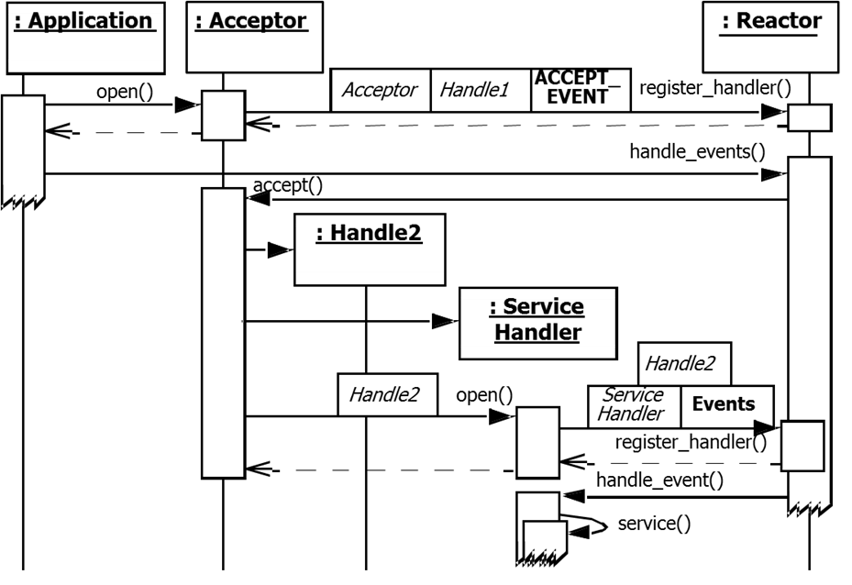
Key Characteristics of Frameworks
They exhibit “inversion of control” via callbacks
They provide integrated domain- specific structures & functionality
e.g., abstract & concrete classes, control flows, etc.
ACE Acceptor-Connector & Reactor frameworks
: Application
: Acceptor
: Reactor
Template method
Passive-mode endpoint initialization phase
Service handler initialization phase
Service handler processing phase
See www.dre.vanderbilt.edu/~schmidt/PDF/Acc-Con.pdf for more info

Slide 19
Key Characteristics of Frameworks
They exhibit “inversion of control” via callbacks
They provide integrated domain- specific structures & functionality
e.g., abstract & concrete classes, control flows, etc.
They are “semi- complete” applications
Application-specific functionality
Electronic Trading
Mobile
Apps
Social Media
Networking
GUI
Database

Slide 20
Key Characteristics of Frameworks
They exhibit “inversion of control” via callbacks
They provide integrated domain- specific structures & functionality
e.g., abstract & concrete classes, control flows, etc.
They are “semi- complete” applications
Application-specific functionality
Electronic Trading
Mobile
Apps
Social Media
Networking
GUI
Hook methods
Database

Slide 21
Key Characteristics of Frameworks
They exhibit “inversion of control” via callbacks
They provide integrated domain- specific structures & functionality
e.g., abstract & concrete classes, control flows, etc.
They are “semi- complete” applications
Completing a framework involves instantiating objects & subclassing & overriding “hook methods”
ACE Acceptor-Connector & Reactor frameworks
Reactor
Event Handler
handle_events()
register_handler()
remove_handler()
handle_event ()
get_handle()
dispatches
*
handle set
<<uses>>
Synchronous
Event Demuxer
Connector
Acceptor
select ()
“Semi-complete” application
Service Handler
App-/Service-specific processing
handle_event ()
get_handle()
See www.dre.vanderbilt.edu/~schmidt/PDF/TAPOS.pdf for more info

Slide 22

Summary
The quality of software (& the productivity of software developers) has historically lagged hardware (& hardware developers)
Inherent & Accidental Complexities

Slide 23
Summary
The quality of software (& the productivity of software developers) has historically lagged hardware (& hardware developers)
Particularly for mission-critical concurrent & networked software

Slide 24

Summary
The quality of software (& the productivity of software developers) has historically lagged hardware (& hardware developers)
Particularly for mission-critical concurrent & networked software
Much cost, effort, & defects stem from continuous rediscovery & reinvention of core concepts & components across software industry
$$$$$$$$$

Slide 25
Summary
The quality of software (& the productivity of software developers) has historically lagged hardware (& hardware developers)
Particularly for mission-critical concurrent & networked software
Much cost, effort, & defects stem from continuous rediscovery & reinvention of core concepts & components across software industry
Frameworks improve productivity & quality of software development by
Reifying proven software designs & implementations in selected domains
Application-specific functionality
Electronic Trading
Mobile
Apps
Social Media
Networking
GUI
Database

Slide 26
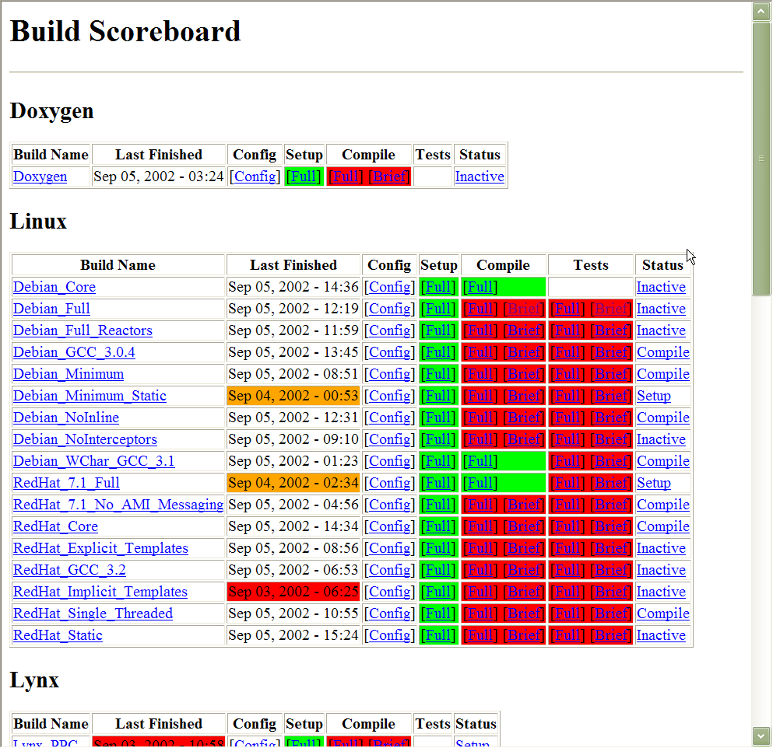
Summary
The quality of software (& the productivity of software developers) has historically lagged hardware (& hardware developers)
Particularly for mission-critical concurrent & networked software
Much cost, effort, & defects stem from continuous rediscovery & reinvention of core concepts & components across software industry
Frameworks improve productivity & quality of software development by
Reifying proven software designs & implementations in selected domains
Amortizing quality assurance efforts & artifacts
www.dre.vanderbilt.edu/scoreboard

Slide 27

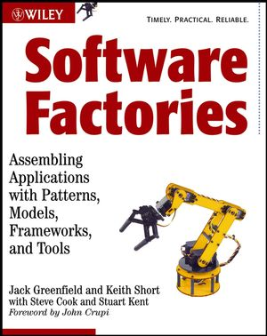
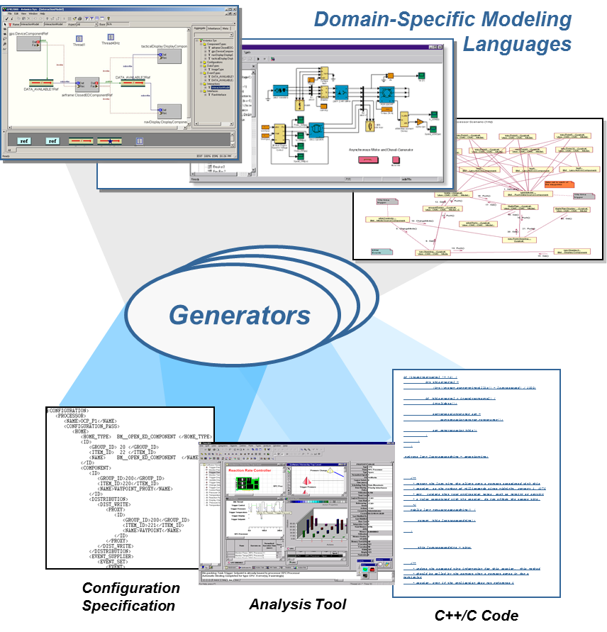
Summary
The quality of software (& the productivity of software developers) has historically lagged hardware (& hardware developers)
Particularly for mission-critical concurrent & networked software
Much cost, effort, & defects stem from continuous rediscovery & reinvention of core concepts & components across software industry
Frameworks improve productivity & quality of software development by
Reifying proven software designs & implementations in selected domains
Amortizing quality assurance efforts & artifacts
w3.isis.vanderbilt.edu/projects/gme
We have a long way to go to match hardware engineers use of modeling tools

Slide 28
Overview of Frameworks: Part 2
Douglas C. Schmidt
d.schmidt@vanderbilt.edu
www.dre.vanderbilt.edu/~schmidt
Professor of Computer Science
Institute for Software Integrated Systems Vanderbilt University Nashville, Tennessee, USA

Slide 29
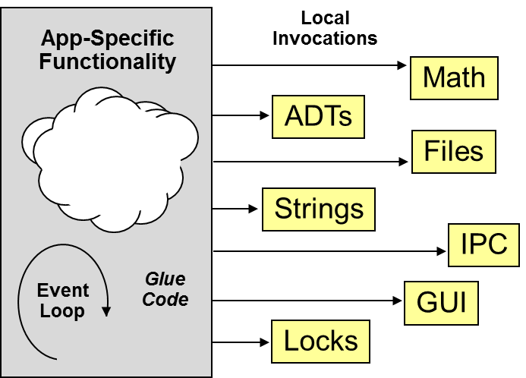
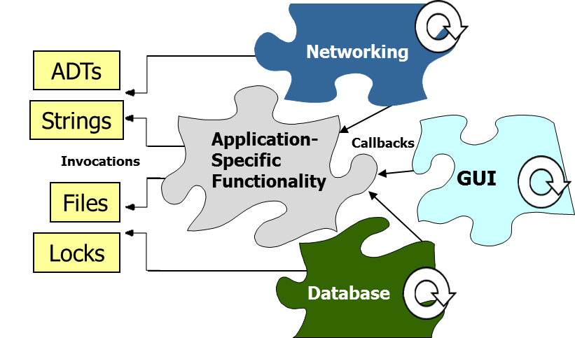
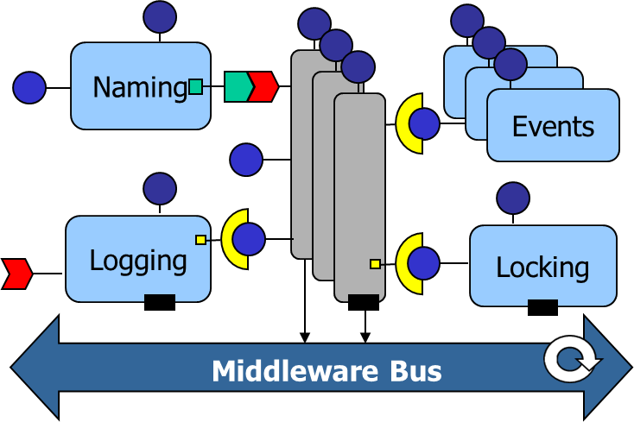
Topics Covered in this Part of the Module
Analyze why hardware has historically improved more consistently than software
Describe key characteristics of frameworks that help improve software productivity & quality
Compare frameworks with other systematic reuse techniques

Slide 30
Topics Covered in this Part of the Module
Analyze why hardware has historically improved more consistently than software
Describe key characteristics of frameworks that help improve software productivity & quality
Compare frameworks with other systematic reuse techniques
Examine different categories of frameworks
Black-box
White-box

Slide 31
Comparing Systematic Reuse Techniques
Class Library Architecture
Class is a reusable implementation unit in an OO language
Classes are typically passive
Local
Invocations
App-Specific
Functionality
Math
ADTs
Files
Strings
IPC
Event Loop
Glue Code
GUI
Locks
See en.wikipedia.org/wiki/Library_(computing)#Object_and_class_libraries

Slide 32
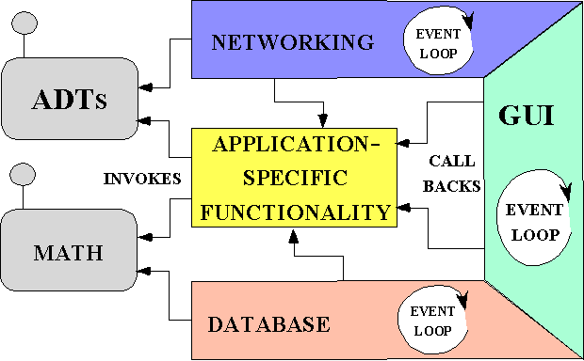
Comparing Systematic Reuse Techniques
Class Library Architecture
Class is a reusable implementation unit in an OO language
Classes are typically passive
Framework Architecture
Framework is integrated set of classes that collaborate to form a reusable architecture for a family of apps
Frameworks own the event loop(s)
Networking
ADTs
Reactor
NETWORKING
Strings
Application- Specific Functionality
Callbacks
Invocations
GUI
Files
Locks
Database
See st-www.cs.illinois.edu/users/johnson/frameworks.html

Slide 33
Comparing Systematic Reuse Techniques
Class Library Architecture
Class is a reusable implementation unit in an OO language
Classes are typically passive
Framework Architecture
Framework is integrated set of classes that collaborate to form a reusable architecture for a family of apps
Frameworks reify pattern languages
Component-based & Service-Oriented Architecture
Component is an encapsulation unit with one or more interfaces that provide clients with access to services
Components can be deployed & configured via meta-data contained in assemblies
Naming
Events
Logging
Locking
Middleware Bus
See www.dre.vanderbilt.edu/~schmidt/report-doc.html for more info

Slide 34
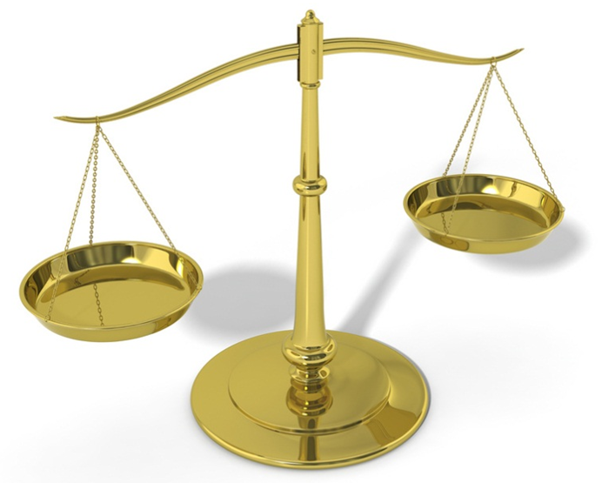
Comparing Systematic Reuse Techniques
Class Library Architecture
Class is a reusable implementation unit in an OO language
Classes are typically passive
Framework Architecture
Framework is integrated set of classes that collaborate to form a reusable architecture for a family of apps
Frameworks reify pattern languages
Component-based & Service-Oriented Architecture
Component is an encapsulation unit with one or more interfaces that provide clients with access to services
Components can be deployed & configured via meta-data contained in assemblies

Slide 35
Categories of Frameworks
Black-box frameworks only require understanding external interfaces of objects
Framework elements typically reused by parameterizing & assembling objects

Slide 36
Categories of Frameworks
Black-box frameworks only require understanding external interfaces of objects
Framework elements typically reused by parameterizing & assembling objects
White-box frameworks require understanding the framework implementation to some degree
Framework elements typically reused by subclassing & overridding
www.laputan.org/drc/drc.html has more on black-box & white-box frameworks

Slide 37
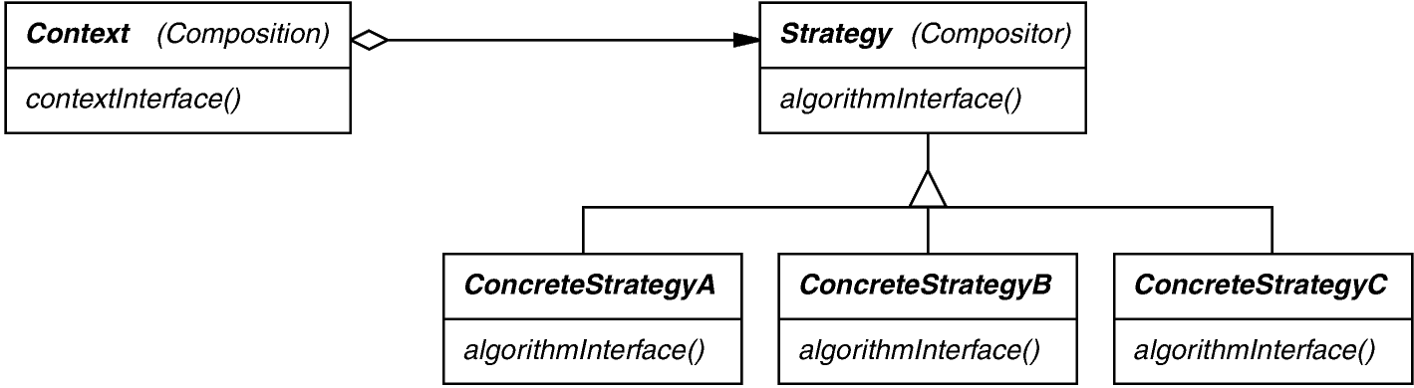
Categories of Frameworks
Black-box frameworks only require understanding external interfaces of objects
Framework elements typically reused by parameterizing & assembling objects
White-box frameworks require understanding the framework implementation to some degree
Framework elements typically reused by subclassing & overridding
Each category of OO framework uses different sets of patterns
Black-box frameworks reply heavily on object composition patterns, such as Strategy & Decorator
en.wikipedia.org/wiki/Strategy_pattern has more on the Strategy pattern

Slide 38
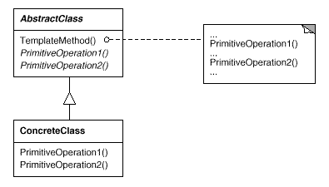
Categories of Frameworks
Black-box frameworks only require understanding external interfaces of objects
Framework elements typically reused by parameterizing & assembling objects
White-box frameworks require understanding the framework implementation to some degree
Framework elements typically reused by subclassing & overridding
Each category of OO framework uses different sets of patterns
White-box frameworks rely heavily on inheritance-based extensibility patterns, such as Template Method & State
en.wikipedia.org/wiki/Template_method has more on Template Method pattern

Slide 39
Categories of Frameworks
Black-box frameworks only require understanding external interfaces of objects
Framework elements typically reused by parameterizing & assembling objects
White-box frameworks require understanding the framework implementation to some degree
Framework elements typically reused by subclassing & overridding
Each category of OO framework uses different sets of patterns
Many frameworks fall in between white-box & black-box categories

Slide 40
Categories of Frameworks
Black-box frameworks only require understanding external interfaces of objects
Framework elements typically reused by parameterizing & assembling objects
White-box frameworks require understanding the framework implementation to some degree
Framework elements typically reused by subclassing & overridding
Each category of OO framework uses different sets of patterns
Many frameworks fall in between white-box & black-box categories
In general
White-box frameworks are easier to develop, but harder to use

Slide 41
Categories of Frameworks
Black-box frameworks only require understanding external interfaces of objects
Framework elements typically reused by parameterizing & assembling objects
White-box frameworks require understanding the framework implementation to some degree
Framework elements typically reused by subclassing & overridding
Each category of OO framework uses different sets of patterns
Many frameworks fall in between white-box & black-box categories
In general
White-box frameworks are easier to develop, but harder to use
Black-box frameworks are harder to develop, but easier to use

Slide 42
White-box Framework: Android AsyncTask
Android’s AsyncTask provides a simple white-box framework to create long-running operations that need to communicate with the UI thread
: UI Thread
: My AsyncTask
: Default Executor
: Worker Runnable
Template method
Perform long-running task
execute
execute
doInBackground
onPreExecute
onPostExecute
Display results in UI
Initialization actions
developer.android.com/reference/android/os/AsyncTask.html has AsyncTask info

Slide 43
White-box Framework: Android AsyncTask
Android’s AsyncTask provides a simple white-box framework to create long-running operations that need to communicate with the UI thread
Must be subclassed
Params – Types used in background work
Progress – Types used when indicating progress
Result – Types of result
AsyncTask
Params, Progress, Result
execute onPreExecute doInBackground onProgressUpdate onPostExecute
Template method
Hook methods
DownloadAsyncTask
onPreExecute doInBackground onPostExecute

Slide 44
White-box Framework: Android AsyncTask
Android’s AsyncTask provides a simple white-box framework to create long-running operations that need to communicate with the UI thread
Must be subclassed
Hook methods can be overridden
class DownloadAsyncTask extends AsyncTask<String, Integer, Bitmap> {
protected void onPreExecute() { dialog.display();
}
protected Bitmap doInBackground(String... url) {
return downloadImage(url[0]);
}
protected void onPostExecute(Bitmap bitmap) {
performPostDownloadOperations(bitmap);
dialog.dismiss();
}
}
Perform on UI thread
Download in background thread
Perform on UI thread

Slide 45
White-box Framework: Android AsyncTask
Android’s AsyncTask provides a simple white-box framework to create long-running operations that need to communicate with the UI thread
Must be subclassed
Hook methods can be overridden
Instance must be created on the UI thread & can only be executed once
public class ThreadedDownloadActivity extends Activity {
…
public void runAsyncTask(View view) {
final String url = urlEditText.getText().toString();
new DownloadAsyncTask().execute(url);
}
…
}
UI thread calls template method to trigger image download in a new AsyncTask

Slide 46
Black-box Framework: Android AsyncTask
Android’s AsyncTask provides a simple black-box framework for controlling the # & behavior of thread(s) running in background
: Download Activity
: Download AsyncTask
: Executor
: Worker Runnable
execute
execute
doInBackground
onPreExecute
onPostExecute
developer.android.com/reference/android/os/AsyncTask.html has AsyncTask info

Slide 47
Black-box Framework: Android AsyncTask
Android’s AsyncTask provides a simple black-box framework for controlling the # & behavior of thread(s) running in background
Client can select the desired Executor
: Download Activity
: Download AsyncTask
: Executor
: Worker Runnable
setDefault Executor (AsyncTask.THREAD_POOL_EXECUTOR)
execute
execute
doInBackground
onPreExecute
onPostExecute
SERIAL_EXECUTOR, THREAD_POOL_EXECUTOR, or custom Executor
Allows multiple long-running tasks to run in parallel in multiple threads

Slide 48
Black-box Framework: Android AsyncTask
Android’s AsyncTask provides a simple black- box framework for controlling the # & behavior of thread(s) running in background
Client can select the desired Executor
Executor treated as a “black-box”
i.e., only requires understanding of external interfaces
: Download Activity
: Download AsyncTask
: Executor
: Worker Runnable
setDefault Executor (AsyncTask.THREAD_POOL_EXECUTOR)
execute
execute
doInBackground
onPreExecute
onPostExecute
Executors can be plugged in as a strategy to AsyncTask
www.dre.vanderbilt.edu/~schmidt/PDF/ICCDS.pdf has C++ black-box example

Slide 49
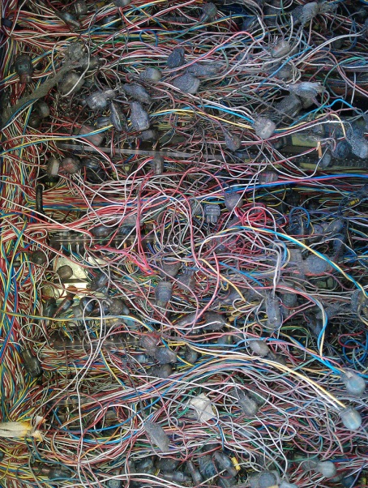
Summary
Frameworks are powerful—but can be hard to develop & use by app developers due to inherent/accidental complexities of various domains

Slide 50
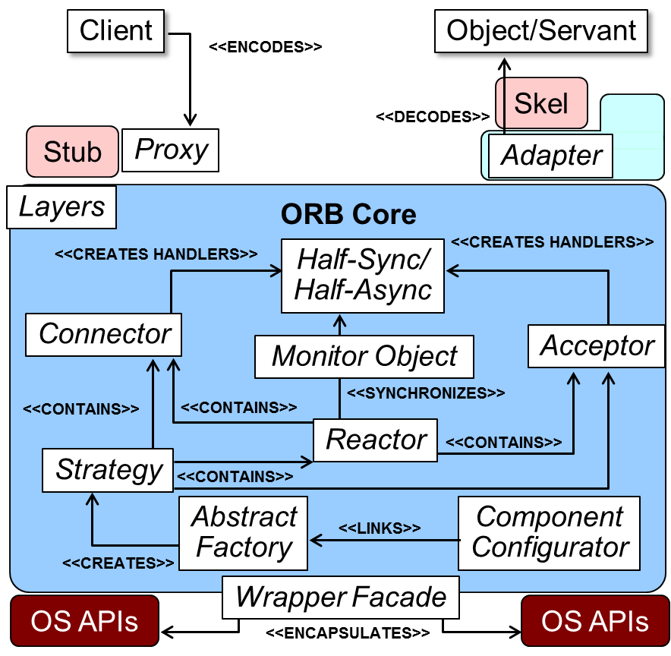
Summary
Frameworks are powerful—but can be hard to develop & use by app developers due to inherent/accidental complexities of various domains
Patterns (especially pattern languages) help to alleviate many framework complexities
www.dre.vanderbilt.edu/~schmidt/PDF/ORB-patterns.pdf has more info

Slide 51

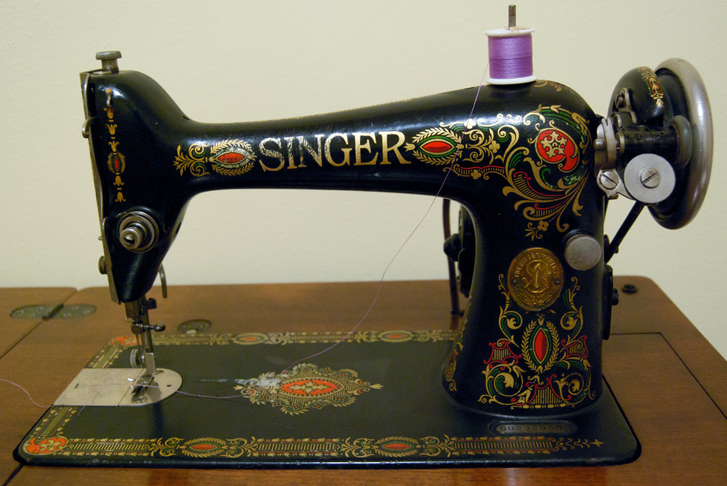
Summary
Frameworks are powerful—but can be hard to develop & use by app developers due to inherent/accidental complexities of various domains
Patterns (especially pattern languages) help to alleviate many framework complexities
It’s often better to use & customize “off-the-shelf” frameworks than to develop frameworks in-house
Notes:
http://www.flickr.com/photos/99743766@N00/3245515267, http://www.flickr.com/photos/80985143@N00/3495801490/

Slide 52
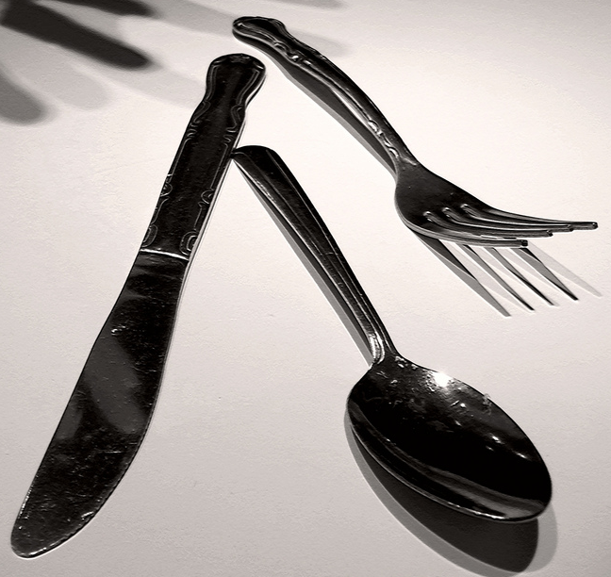
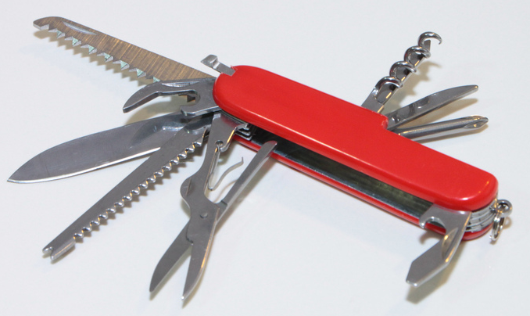
Summary
Frameworks are powerful—but can be hard to develop & use by app developers due to inherent/accidental complexities of various domains
Patterns (especially pattern languages) help to alleviate many framework complexities
It’s often better to use & customize “off-the-shelf” frameworks than to develop frameworks in-house
Components & services are easier for app developers to use, but aren’t as powerful or flexible as frameworks
Notes:
http://www.flickr.com/photos/28958738@N06/7304232902/, http://www.flickr.com/photos/49503118795@N01/4096827907/

Slide 53
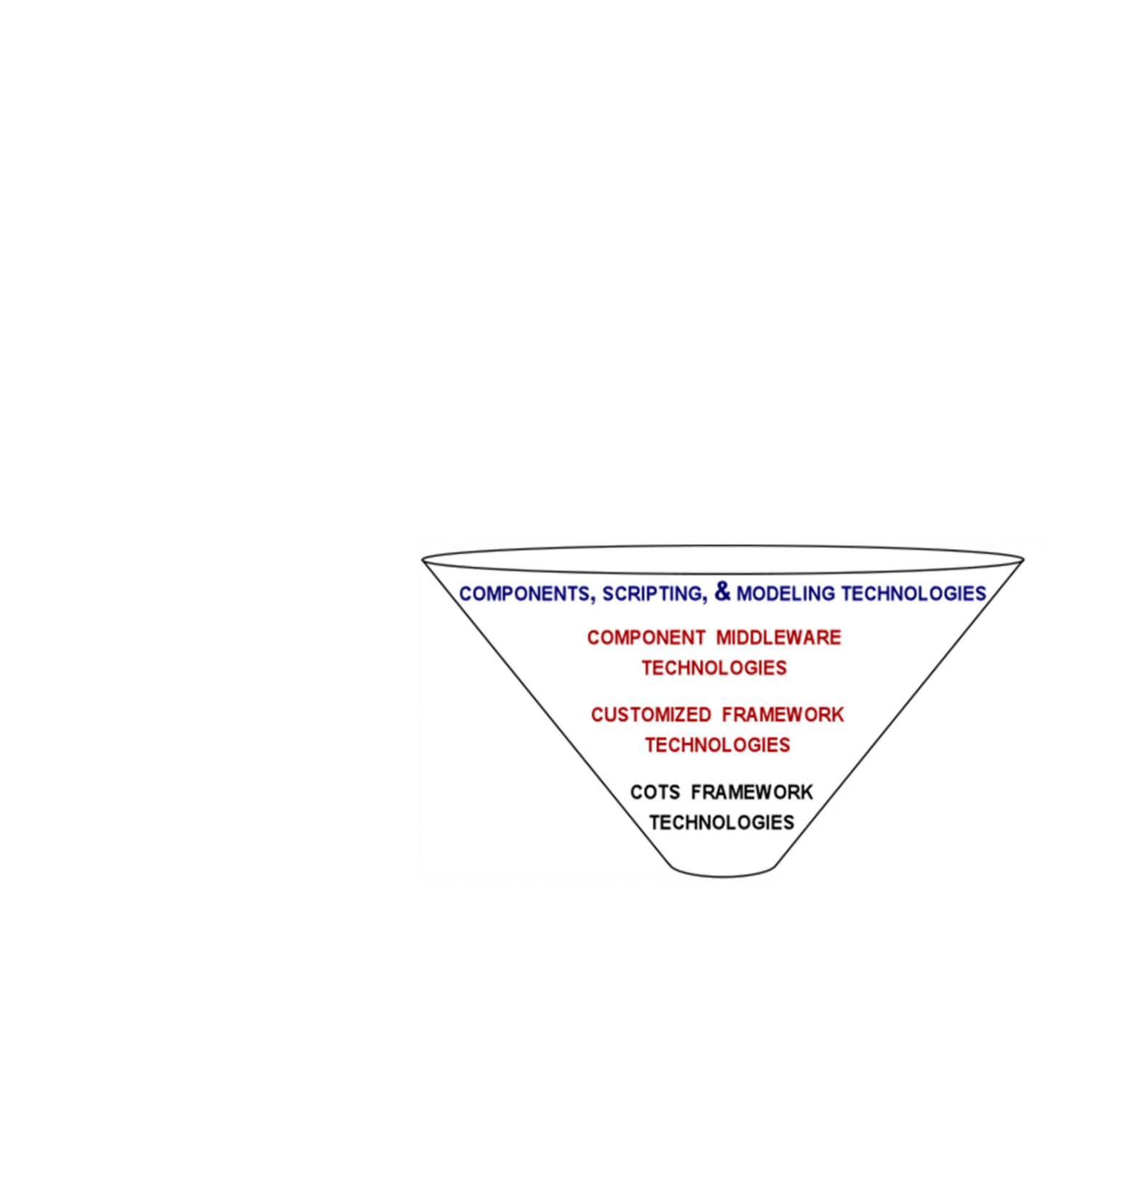
Summary
Application Developers
Frameworks are powerful—but can be hard to develop & use by app developers due to inherent/accidental complexities of various domains
Patterns (especially pattern languages) help to alleviate many framework complexities
It’s often better to use & customize “off-the-shelf” frameworks than to develop frameworks in-house
Components & services are easier for app developers to use, but aren’t as powerful or flexible as frameworks
Successful software projects are therefore often best organized using the “funnel” model
Infrastructure Developers
Infrastructure Developers
Off-the-Shelf Framework Developers
www.dre.vanderbilt.edu/~schmidt/PDF/Queue-04.pdf has more on frameworks

Slide 54
Reactor
*
Event Handler
handle_events()
register_handler()
remove_handler()
dispatches
handle_event ()
get_handle()
*
owns
Handle
*
handle set
notifies
<<uses>>
Synchronous
Event Demuxer
Connector
Acceptor
select ()
Service
Handler

